Slide 1

Elliptic Curve Cryptography
Lecture by :
Dr. Anil Pinapati
Assistant Professor
Department of C.S.E
NIT Calicut

Slide 2
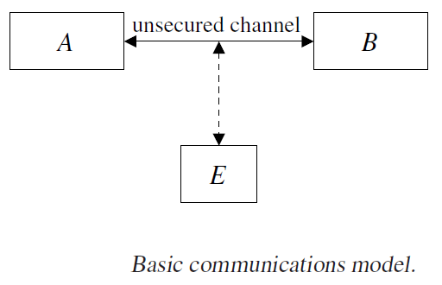
Introduction
Cryptography is an analysis and design of mathematical model which establishes communication between two parties in the presence of malicious adversary.

Slide 3
Basic Terminology
Plain text(P): Text that user can understand/readable
Cipher Text(C): Text that is not readable
Encryption(E): The process of converting plain text to cipher text.
C=E(P, k)=Ek(P)
Decryption(D): The process of converting cipher text to plain text.
P=D(C, k)=Dk(P) where k is secret key
P=Dk(Ek(P)).

Slide 4
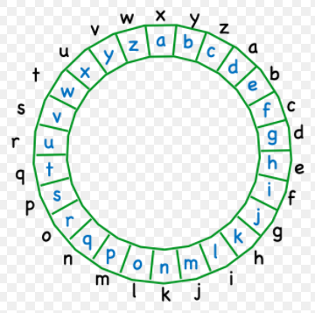
Basic Caesar Cipher
En(m)=c=(m+n) mod 26.
Dn(m)=m=(c-n) mod 26
Ex:- plain(m)=i am in lbs
cipher(c)=lxdpxlqxoev

Slide 5
Security Goals: CIAEN
The CIA Triad of confidentiality, integrity and availability is considered the core underpinning of information security.
Confidentiality: Confidentiality measures protect information from unauthorized access and misuse.
Integrity: Integrity measures protect information from unauthorized alteration.
Availability : In order for an information system to be useful it must be available to authorized users.
Entity authentication: Corroborating the identity of an entity—B should be convinced of the identity of the other communicating entity.
Non-repudiation: Preventing an entity from denying previous commitments or actions

Slide 6
Cryptography
Symmetric/Private key cryptography:
RC4,
DES(Data Encryption Standard),
AES(Advanced Encryption Standard)
Asymmetric/Public key cryptography:
RSA,
El-Gamal,
Elliptic Curve Cryptography(ECC)

Slide 7
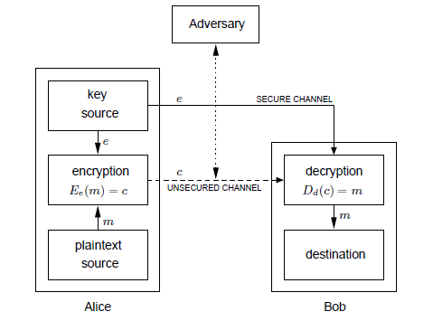
Conti...
Symmetric Key Cryptography

Slide 8
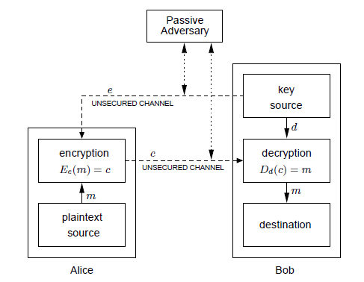
Public Key Cryptography

Slide 9
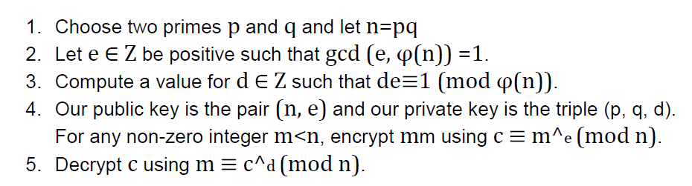
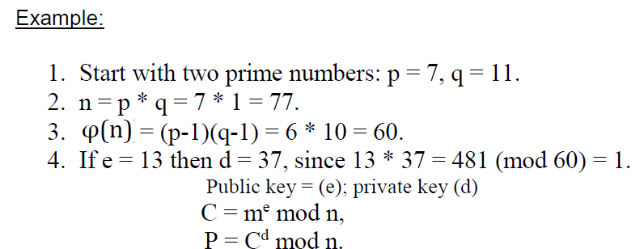
RSA(Rivest, Shamir, Adelman)

Slide 10
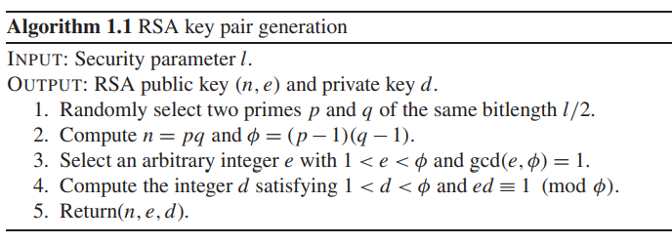
RSA Key Generation

Slide 11
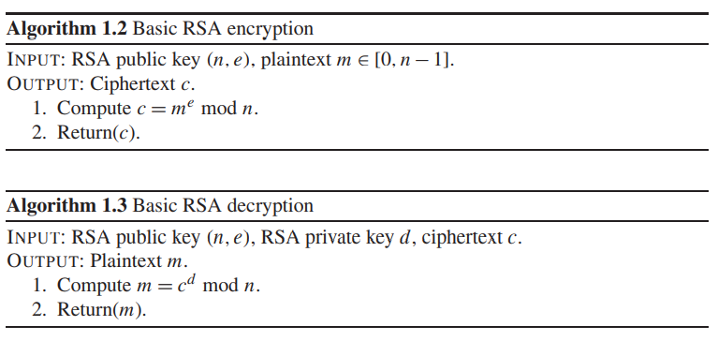
RSA Encryption and Decryption

Slide 12
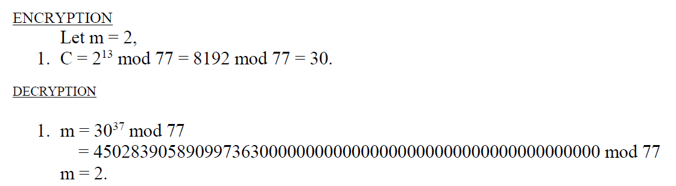
Cont…

Slide 13
Discrete Logarithm Problem
public domain parameters (p, q, g). Here, p is a prime, q is a prime divisor of p−1, and g ∈ [1, p−1] has order q (i.e., t = q is the smallest positive integer satisfying g^t ≡ 1(mod p)).
A private key is an integer x that is selected uniformly at random from the interval [1,q −1] (this operation is denoted x ∈R [1,q −1]), and the corresponding public key is y = g^x mod p.
The problem of determining x given domain parameters (p, q, g) and y is the Discrete Logarithm Problem (DLP).

Slide 14
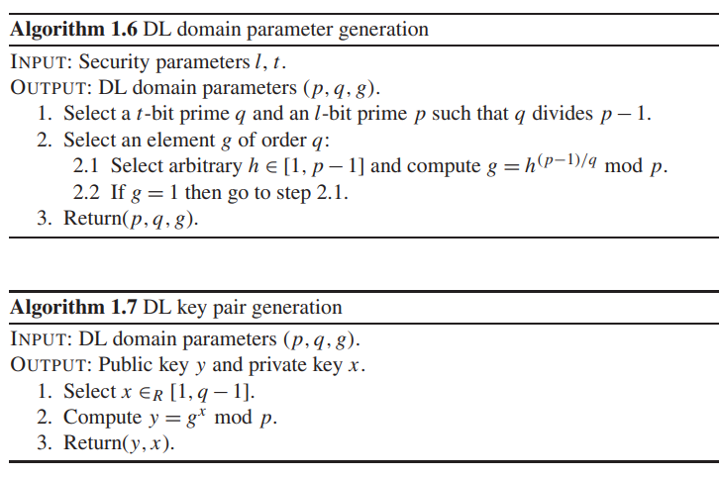
DL domain parameters and key pair generation

Slide 15
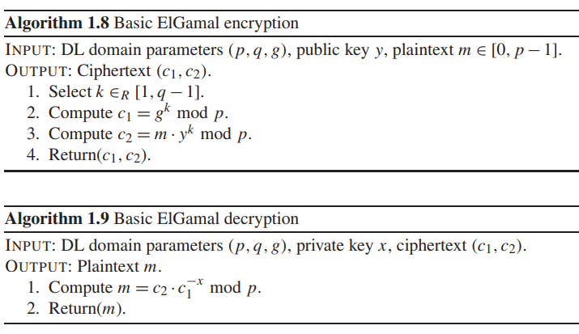
El-Gamal Encryption and Decryption

Slide 16
Elliptic curves in Cryptography
Elliptic Curve (EC) systems as applied to cryptography were first proposed in 1985 independently by Neal Koblitz and Victor Miller.
The Discrete Logarithm Problem(DLP) on elliptic curve groups is believed to be more difficult than the corresponding problem in (the multiplicative group of nonzero elements of) the underlying finite field.

Slide 17
Definition of Elliptic curves
An elliptic curve over a field K is a nonsingular cubic curve in two variables, f(x,y) =0 with a rational point (which may be a point at infinity).
The field K is usually taken to be the complex numbers, reals, rationals, algebraic extensions of rationals, p-adic numbers, or a finite field.
Elliptic curve groups for cryptography are examined with the underlying fields of F_{p} (where p>3 is a prime) and F₂^{m} (a binary representation with 2^{m} elements).

Slide 18
Advantages of ECC
It provides all the benefits of the other cryptosystems like: confidentiality, integrity, authentication and non-repudiation.
Shorter key lengths
Encryption, Decryption and Signature verification speed up
Storage and bandwidth savings
Table 1:- key comparison between private and public key cryptography.
Security bits | RSA | ElGamal | Elliptic
80 | 1024 | 1024 | 160
112 | 2048 | 2048 | 224
128 | 3074 | 3074 | 256
192 | 7680 | 7680 | 384
256 | 15360 | 15360 | 512

Slide 19
Applications of ECC
Many devices are small and have limited storage and computational power
Where can we apply ECC?
Wireless communication devices
Smart cards
Web servers that need to handle many encryption sessions
Any application where security is needed but lacks the power, storage and computational power that is necessary for our current cryptosystems

Slide 20
Security of ECC?
Security of Public Key Cryptosystem: It relies on the evaluation of the computational difficulty of some families of mathematical problems and its complexity.
How do we analyze Cryptosystems?
How difficult is the underlying problem that it is based upon
RSA – Integer Factorization(n=pq)
DH – Discrete Logarithms(y=a^x)
ECC - Elliptic Curve Discrete Logarithm problem(Q=sP)
How do we measure difficulty?
We examine the algorithms used to solve these problems

Slide 21
ECC operations: Hierarchy
ECC
Level 0
Point
multiplication:
kP
Level 1
Group operation:
point add/double
Level 2
Parallelize the architectures
Finite field arithmetic: multiplication,
addition, subtraction, inversion, …
Level 3

Slide 22
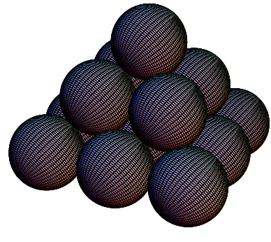
Introduction to Elliptic Curves Lets start with a small puzzle
What is the number of balls that may be piled as a square pyramid and also rearranged into a square array?
Soln: Let x be the height of the pyramid…
Thus,
We also want this to be a square:
Hence,

Slide 23
Graphical Representation
Y axis
X axis
Curves of this nature
are called ELLIPTIC
CURVES

Slide 24
Method of Diophantus
Uses a set of known points to produce new points
(x1,y1)=(0, 0) and (x2,y2)=(1, 1) are two trivial solutions
Equation of line through these points is y=x.
y=m(x-x1)+y1
Intersecting with the curve and rearranging terms:
=>
We know that from quad. eq i.e. a+b+c=-co.iff(x²)
∴ 1 + 0 + x = 3/2 => x = ½ and y = ½
Using symmetry of the curve we also have (1/2,-1/2) as another solution.

Slide 25
Diophantus’ Method
Consider the line through (1/2,-1/2) and (1,1), i.e., y=m(x-x1)+y1=>y=3(x-1/2)-1/2=>y=3x-2
Intersecting with the curve we have:
Thus ½ + 1 + x = 51/2 or x = 24 and y=70
Thus if we have 4900 balls we may arrange them in either way. (means Pyramid or Square)

Slide 26
Introduction about Groups
A group is a non-empty set G equipped with a binary operation * that satisfies the following properties for all a, b, c in G:
1. Closure : a, b in G, a. b is also in G.
2. Associativity: (a*b)*c = a*(b*c)
3. Identity: There exists an element e in G such that
a*e =e*a = a. We call e the identity element of G.
4. Inverse: For each a in G, there exists an element d in G
such that a*d = e = d*a. We call d is the inverse of a.
If a group G also satisfies the following property for all a, b in G
5. Commutativity: a*b = b*a, we say G is an abelian group.
The order of a group G is denoted by |G| is the number of elements in G.

Slide 27
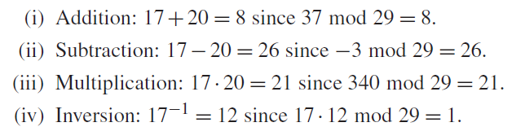
Galois Field GF(P)
It is a finite field and it consists of a set of integers {0,1,2,3….P-1} where P is a prime number. Additionally it satisfies the following arithmetic operations with P=29

Slide 28
Galois Field GF(2^{m})
It is a finite field and is called binary finite field. It is a vector space of dimension m over GF(2) i.e. there exists a set of m elements {α_{m-1}, …,α₁, α₀} each α_{i} ∈{0,1} in GF(2^{m}) such that each a ∈ GF(2^{m})
a = α_{m-1}x^{m-1} + … + α₁x + α₀
Additionally it satisfies the following arithmetic operations :
For instance a = {a_{m-1},…,a₁,a₀} and b = {b_{m-1},…,b₁,b₀} ∈ GF(2^{m})
Addition : a + b = c = {c_{m-1},…,c₁,c₀} where c_{i} = (a_{i} + b_{i}) mod 2 finally c ∈ GF(2^{m}) .
Multiplication : a . b = c = {c_{m-1},…,c₁,c₀} where c is the remiander of the division of the polynomial a(x) . b(x) by an irreducible polynomial of degree m. c ∈ GF(2^{m})

Slide 29
Weierstrass Equation
Generalized Weierstrass Equation of elliptic curves:
Here, a, b, x and y all belong to a field of say rational
numbers, complex numbers, finite fields (F_{p}) or
Galois Fields (GF(2^{n})).

Slide 30
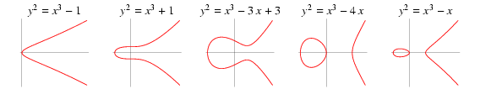
Types of Elliptic Curves
An elliptic curve is a plane curve char(k)≠2,3
An elliptic curve with char(k)=2
Koblitz curves:

Slide 31
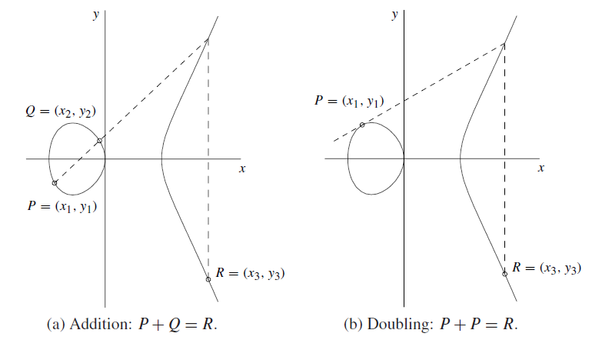
Point addition and Point doubling in graphical representation
P,Q,R are points on the curve.

Slide 32
Group laws of ECC where Char(p)>3
P and Q be two points on E_{(a,b)}(Fp) and O is the point at infinity.
1. Additive Identity : P+O = O+P = P
2. Negation : If P = (x₁, y₁) then (-P) = (x₁ ,-y₁)
and P + (-P) = O.
3. Point addition : If P = (x₁, y₁) and Q = (x₂, y₂), and P and Q are not O. then P +Q = (x₃, y₃) where
x₃ = λ² - x₁ - x₂
y₃ = λ(x₁ - x₃) - y₁
where λ = (y₂-y₁)/(x₂-x₁) if P ≠ Q
4. Point Doubling: P+P=2P,P not equal to –P.
x₃ = λ² - 2x₁ ,
y₃ = λ(x₁ - x₃) - y₁
Where λ = (3x₁²+a)/ 2y₁ if P = Q

Slide 33
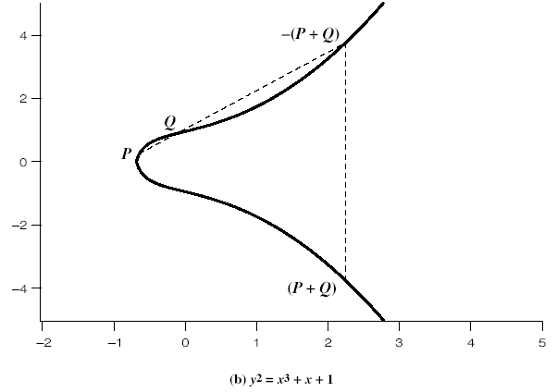
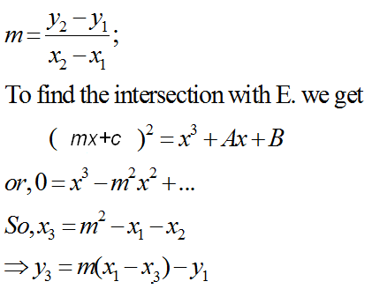
Addition in Affine Co-ordinates
y=mx+c
y
Let, P≠Q,
x
y²=x³+Ax+B

Slide 34
Doubling of a point
Let P=Q, and take the derivative of Equation, derivation of y with respect to x.

Slide 35
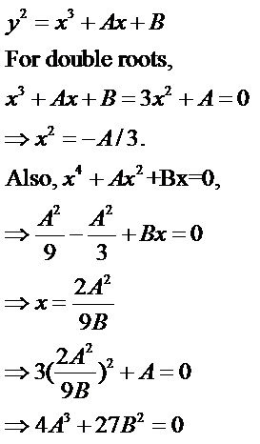
If Characteristics of field is not 2, 3:
Hence condition for no singularity is 4A³+27B²≠0
Generally, EC curves have no singularity

Slide 36
For Instance Point Addition and Doubling
Take an Elliptic Curve E_{(4,20)}:y²=x³+4x+20 ∈ F₂₉
Set of points generated using the curve E is
O, (2,6) (4,19) (8,10) (13,23) (16,2) (19,16) (27,2),(0,7) (2,23) (5,7) (8,19) (14,6) (16,27) (20,3) (27,27), (0,22) (3,1) (5,22) (10,4) (14,23) (17,10) (20,26), (1,5) (3,28) (6,12) (10,25) (15,2) (17,19) (24,7), (1,24) (4,10) (6,17) (13,6) (15,27) (19,13) (24,22)
Point addition :-where P=(5, 22), Q=(16, 27) , P+Q=(13,6)
λ = (y₂-y₁)/(x₂-x₁) mod (29) = ((27-22)/(16-5)) mod 29=(5/11)mod 29
=> (5*8) mod 29=11. (Because (11*8)=1mod 29)
x₃ = λ² - x₁ - x₂ (29)=> ((11*11)-5-16)mod (29)=> 100 mod 29=13
y₃ = λ(x₁ - x₃) - y₁ (29)=>(11(5-13)-22)mod 29 => -110 mod 29=6
Point Doubling :- where P=(5,22) 2P=P+P=(14,6)
λ = (3x₁²+a)/ 2y₁ (29) =>( (3(5*5)+4)/(2*22))mod 29=>13
x₃ = λ² - 2x₁ (29)=> (13*13)-2*5 (29)=> 14
y₃ = λ(x₁ - x₃) - y₁ (29)=>(13(5-14)-22 (29) => 6.

Slide 37
Points on the Elliptic Curve (EC)
Elliptic Curve over field L
It is useful to add the point at infinity
The point is sitting at the top of the y-axis and any line is said to pass through the point when it is vertical
It is both the top and at the bottom of the y-axis

Slide 38
The Points P,Q form Abelian Group
Given two points P,Q in E(Fp), there is a third point, denoted by R=P+Q on E(Fp), and the following relations hold for all P, Q, R in E(Fp)
P + Q = Q + P (commutativity)
(P + Q) + R = P + (Q + R) (associativity)
P + O = O + P = P (existence of an identity element)
there exists ( − P) such that − P + P = P + ( − P) = O (existence of inverses)

Slide 39
Elliptic Curve on a finite set of Integers Z/5Z
Consider y² = x³ + 2x + 3 (mod 5)
x = 0 ⇒ y² = 3 ⇒ no solution (mod 5)
x = 1 ⇒ y² = 6 = 1 ⇒ y = 1,4 (mod 5)
x = 2 ⇒ y² = 15 = 0 ⇒ y = 0 (mod 5)
x = 3 ⇒ y² = 36 = 1 ⇒ y = 1,4 (mod 5)
x = 4 ⇒ y² = 75 = 0 ⇒ y = 0 (mod 5)
Then points on the elliptic curve are
(1,1) (1,4) (2,0) (3,1) (3,4) (4,0) and the point at infinity: ∞
Using the finite fields we can form an Elliptic Curve Group
where we also have a DLP problem which is harder to solve…

Slide 40
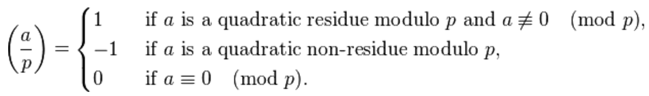
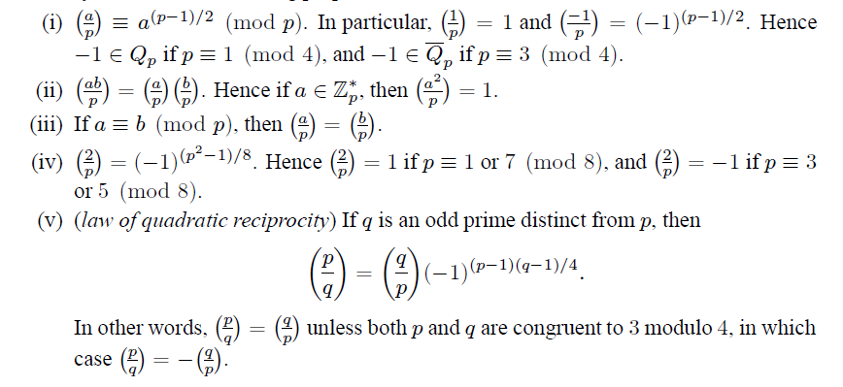
Continuation…
How do we say that y² = a(P) has solution with respect to F_{p} ?
Using Legendre and Jacobi symbol.

Slide 41
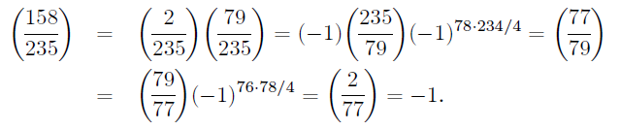
For Instance:
4th property 235=3(8) yield -1
5th property law of reciprocity
5th property law of reciprocity
4th property 77=5(8) yield -1

Slide 42
Implementation of scalar multiplication in ECC kP=P+P+……+P; k times k is scalar

Slide 43
Scalar Multiplication: MSB first
Require k=(k_{m-1},k_{m-2},…,k₀)₂, k_{m-1}=1
Compute Q=kP
Q=P
For i=m-2 to 0
Q=2Q
If k_{i}=1 then
Q=Q+P
End if
End for
Return Q
Sequential Algorithm
Requires m point doublings and
(m-1)/2 point additions on the
average

Slide 44
Example
Compute 7P:
7=(111)₂
7P=2(2(P)+P)+P=> 2 iterations are required
Principle: First double and then add (accumulate)
Compute 6P:
6=(110)₂
6P=2(2(P)+P)

Slide 45
Scalar Multiplication: LSB first
Require k=(k_{m-1},k_{m-2},…,k₀)₂, k_{m-1}=1
Compute Q=kP
Q=0, R=P
For i=0 to m-1
If k_{i}=1 then
Q=Q+R
End if
R=2R
End for
Return Q
Can Parallelize…
What you are doubling and what
you are accumulating are
different…
On the average m/2 point
Additions and m/2 point
doublings

Slide 46
Example for scalar multiplication
Compute 7P, 7=(111)₂, Q=0, R=P
Q=Q+R=0+P=P, R=2R=2P
Q=P+2P=3P, R=4P
Q=7P, R=8P
Compute 6P, 6=(110)₂, Q=0, R=P
Q=0, R=2R=2P
Q=0+2P=2P, R=4P
Q=2P+4P=6P, R=8P

Slide 47
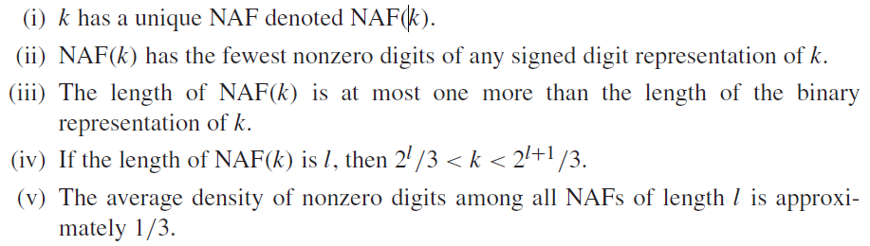
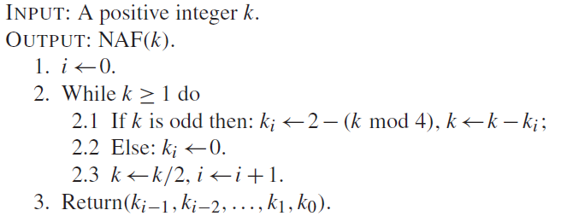
Scalar multiplication using NAF
In binary the remainders are {0,1}, but in NAF remainders are {0,1,-1},k is a scalar.

Slide 48
Continuation…
For instance k=31.
(Binary) = (NAF)
(11111) = (1 0 0 0 0 -1)
For instance k=61
(Binary) = (NAF)
(111101) = (1 0 0 0 -1 0 1)

Slide 49
Scalar Multiplication in ECC (sP=P+P+……+P) is adding P to P, s number of times.
S.No | Method | Binary notation of “s” , P is Point | add-and-double | Operations
1 | LSB | 31P=(11111)₂ | 16P 8P 4P 2P P 1 1 1 1 1 31P 15P 7P 3P P | 4D+4A (n-1)D+(nz-1)A
2 | MSB | 10P=(1010)₂ | P 2P 4P 10P 1 0 1 0 P 2P 5P 10P | 3D+1A (n-1)D+(nz-1)A
3 | NAF | 31P=(10000-1)₂ | 32P 16P 8P 4P 2P P 1 0 0 0 0 -1 31P - P | 5D+1A (n-1)D+(nz-1)A
4 | Montgomery Algorithm | 10P=(1010)₂ | 2P 3P 6P 11P 1 0 1 0 P 2P 5P 10P | 4D+3A (n)D+(n-1)A
A: Point addition, D: point doubling , n is length of binary notation of scalar s, nz: number of non-zeros in binary notation of “s”.

Slide 50
Encode msg(M) to Msg point on the curve
M to P_{M} point conversion.
1. X_{j}= 100 * M + j; where 0≤M<(P/100), 0≤j<100.
2. S_{j}=(X_{j})³+aX_{j}+b (mod P), (X₀,X₁,……..,X₉₉).
3. Legendre(S_{j}, P)=1.
Then P ≡ 3 mod 4. Y_{j}=(S_{j}) ^{(p+1)/4}(mod P), break.
(Algo 2.143)(modular exponensation a^k mod p)
else inc(j) , goto step 1.
output P_{M} =(X_{j},Y_{j}).
P_{M} to M convertion.
1. M=Floor(X_{j}/100).

Slide 51
Encryption & Decryption Process using Elliptic Curve Cryptosystems (ECC)

Slide 52
Key Generation:
Alice
Bob
A sending to B
Suppose Alice wants to send to Bob an encrypted message.
Both agree on a base point B. Alice and Bob create public/private keys.
n is order of G contains all points, n=#E(Fp), nB=O.
Alice
Private Key a ={1,2,……..n-1}
Public Key = P_{A} = a * B
Bob
Private Key b = {1,2,………..,n-1}
Public Key = P_{B} = b * B
Alice takes plaintext message M, and encodes it onto a point, P_{M}, from the elliptic group.

Slide 53
Encryption and Decryption (Cont…)
Alice chooses another random integer, k=[1, p-1]
The ciphertext is a pair of points
P_{C} = [ C1=(kB), C2=(P_{M} + kP_{B}) ]
To decrypt P_{M} from C1,C2, Bob computes ,using private key, b
P_{M} =C2 - b * C1.
Bob then takes this product and subtracts it from the second point from P_{C}
(P_{M} + kP_{B}) – [b(kB)] = P_{M} + k(bB) – b(kB) = P_{M}
Bob then decodes P_{M} to get the message, M.

Slide 54
Summary of ECC
“Hard problem” analogous to discrete log
Q=kP, where Q,P belong to a prime curve
given k,P → “easy” to compute Q
given Q,P → “hard” to find k
known as the elliptic curve discrete logarithm problem
k must be large enough
ECC security relies on elliptic curve logarithm problem
compared to factoring, can use much smaller key sizes than with RSA etc

Slide 55
Topic wise Preferred Textbooks
Group laws and scalar multiplication
Guide to ECC p.no: 80,96.
Mathematical formulas, Legendre and jacobi symbol
Hand book of applied cryptography p.no: 73
Massage point representation, El-Gamal Elliptic curve cryptography
Elliptic curve cryptography & number theory(pg no – 173,174,175)

Slide 56
Implementation of ECC over GF(2^{m})

Slide 57
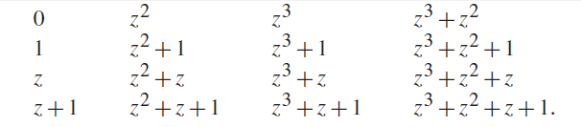
Binary Field GF(2^{m})
Binary Field
Field elements of Binary field F₂4

Slide 58
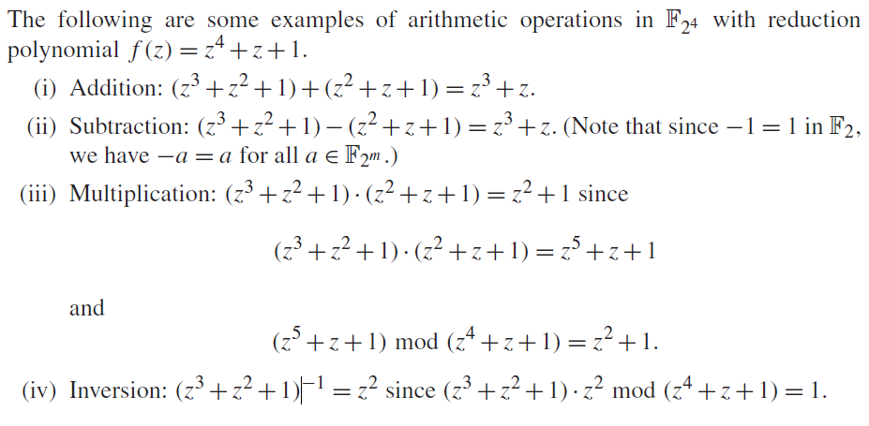
Conti…

Slide 59
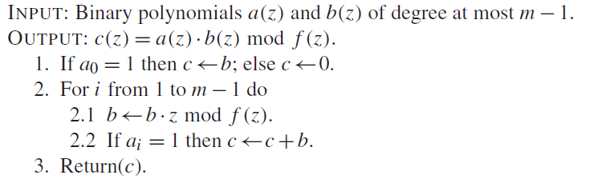

Conti…
Binary multiplication:
Binary squaring:

Slide 60
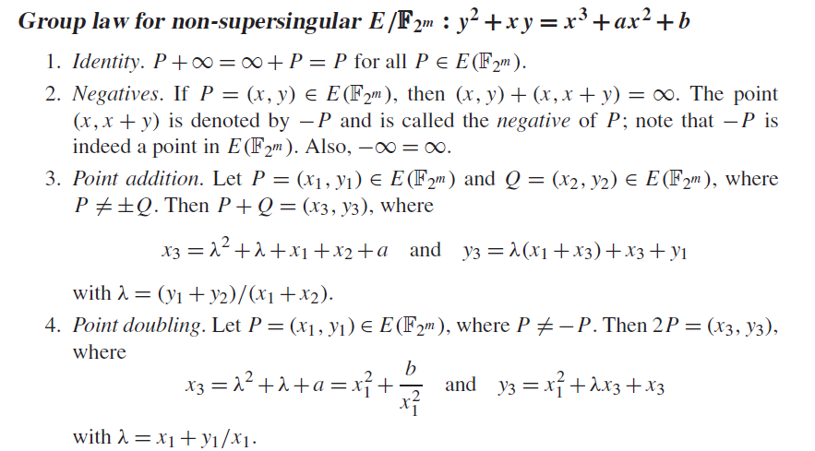
Group laws with respect to 2^{m}

Slide 61



Koblitz Curves
Koblitz curves are very efficient and it doesn’t require doubling.

Slide 62
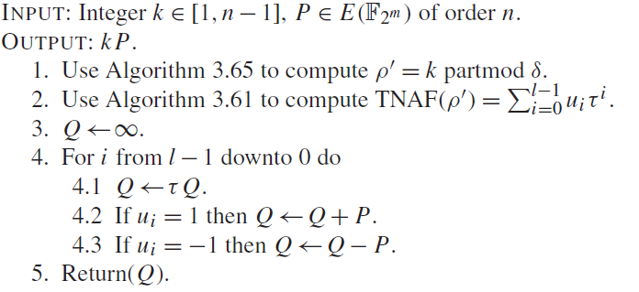
Scalar multiplication
Multiplying koblitz curves . Time complexity (m/3)A.

Slide 63
Research Directions
Proposed algorithms will perform more efficient if we make parallel execution of statements.
Trying to embed updated ECC on Koblitz curves in different places where older methods are using for security. For instance we are trying to embed ECC on SIP Protocol in VOIP.
Increase the efficiency of ECC further using Hyper elliptic curves and Cab curves. Trying to increase the research to the maximum level which is useful for real time problems.
Finding different methods to represent a scalar like partitioning scalar into 2 parts applying different ways to represent first and second part.
τ^{n} -NAF generalization where n=3, 4, …

Slide 64
References
J. Lopez and R. Dahab, “Fast Multiplication on Elliptic Curves over GF(2^{m}) without pre-computation”, CHES 1999
K. Fong etal, “Field Inversion and Point Halving Revisited”, IEEE Trans on Comp, 2004
Koblitz.N., “Elliptic Curve Cryptosystems,” Math. Computation, vol. 48, pp. 203-209, Jan. 1987.
Solinas. J.A., “Efficient Arithmetic on Koblitz Curves,” Design, Codes and Cryptography, vol. 19, pp. 195-249, Mar. 2000.
Avanzi.R.M., Ciet. M., and Sica.F. Faster Scalar Multiplication on Koblitz Curves combining Point Halving with the Frobenius Endomorphism. Proceedings of PKC 2004, LNCS 2947, Springer 2004.
Knudsen. E.W., Elliptic Scalar Multiplication Using Point Halving. In: Proceedings of ASIACRYPT 1999, LNCS 1716, pp. 135-149. Springer, 1999.
Sujoy Sinha Roy, Chester Rebeiro, Debdeep Mukhopadhyay, Junko Takahashi and Toshinori Fukunaga, Scalar multiplication on Koblitz curves using τ2 – NAF, 2009.
Fong. K., Hankerson. D., Lopez. J., and Menezes. A,”Field inversion and point halving revisited”. IEEE Transactions on Computers 53(8):1047-1059, 2004.

Slide 65
Books:
[Slides borrowed from Prof. D. Mukhopadhyay, IIT Kharagpur]. Microsoft Powhttps://cse.iitkgp.ac.in/~debdeep/pres/TI/ecc.pdferPoint - ecc (iitkgp.ac.in).
Elliptic Curves: Number Theory and Cryptography, by Lawrence C. Washington
Hand book of applied cryptography, Alfred J. Menezes
Guide to Elliptic Curve Cryptography, Darrel R. Hankerson, A. Menezes and A. Vanstone
http://cr.yp.to/ecdh.html ( Daniel Bernstein)

Slide 66

Thank You
Doubts?

